Slide 1

Systems biology of vaccination for seasonal influenza in humans
Nakaya, H., Wrammert, J., Lee, E. et al. (2011)
Presented by Team Sydney Brenner
Erica Anton, Annelisa Faché, Ziqing Yu
September 26, 2024

Slide 2
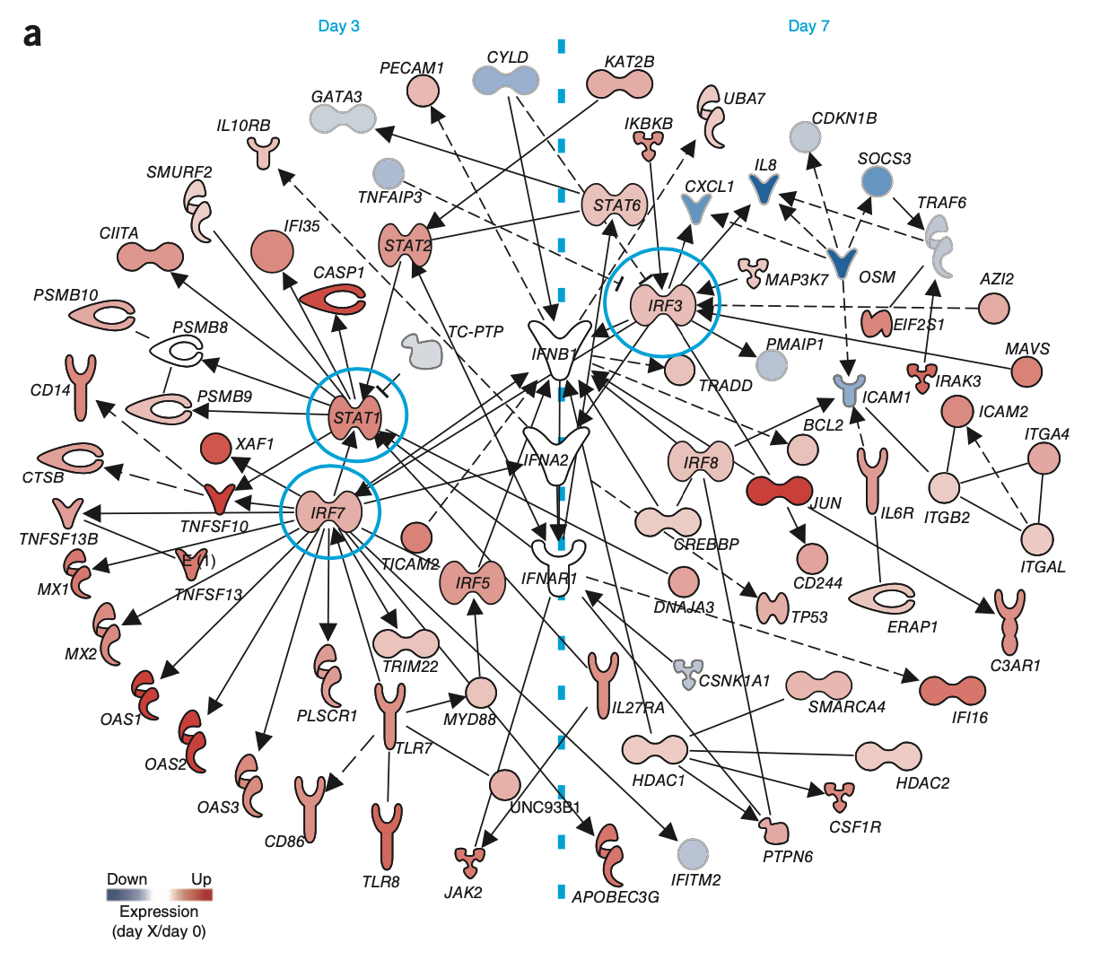
Introduction

Slide 3
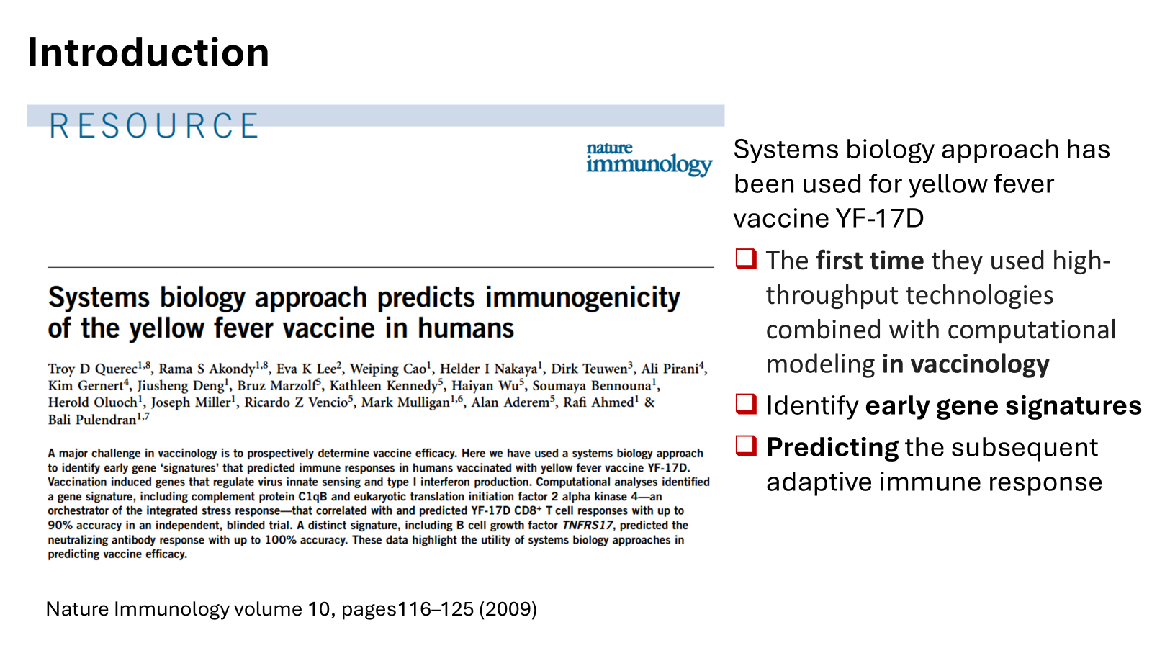
Introduction

Slide 4
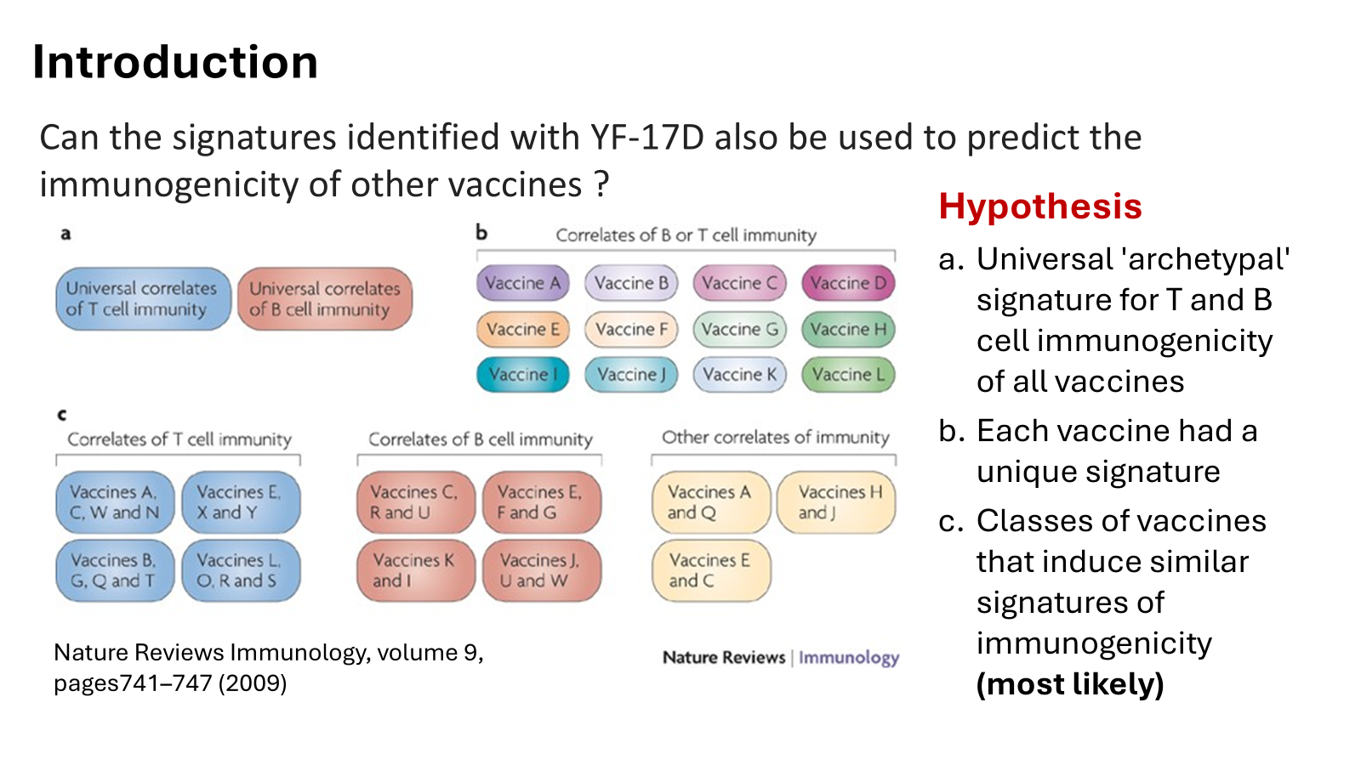

Slide 5
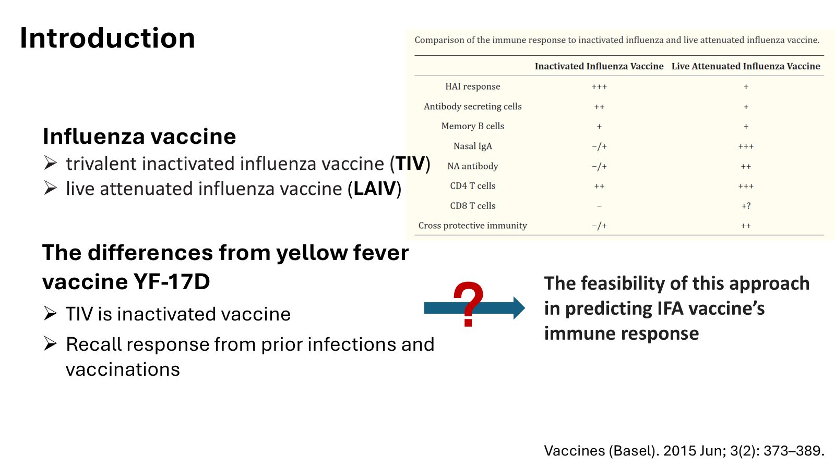

Slide 6
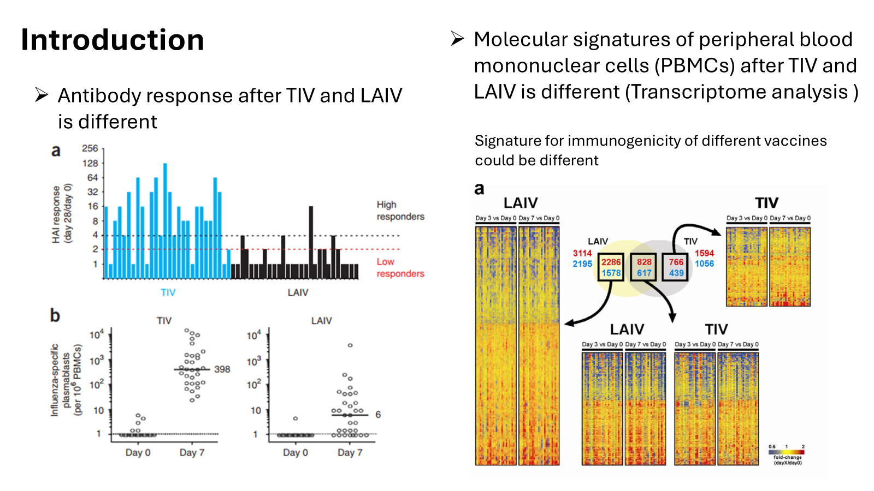

Slide 7
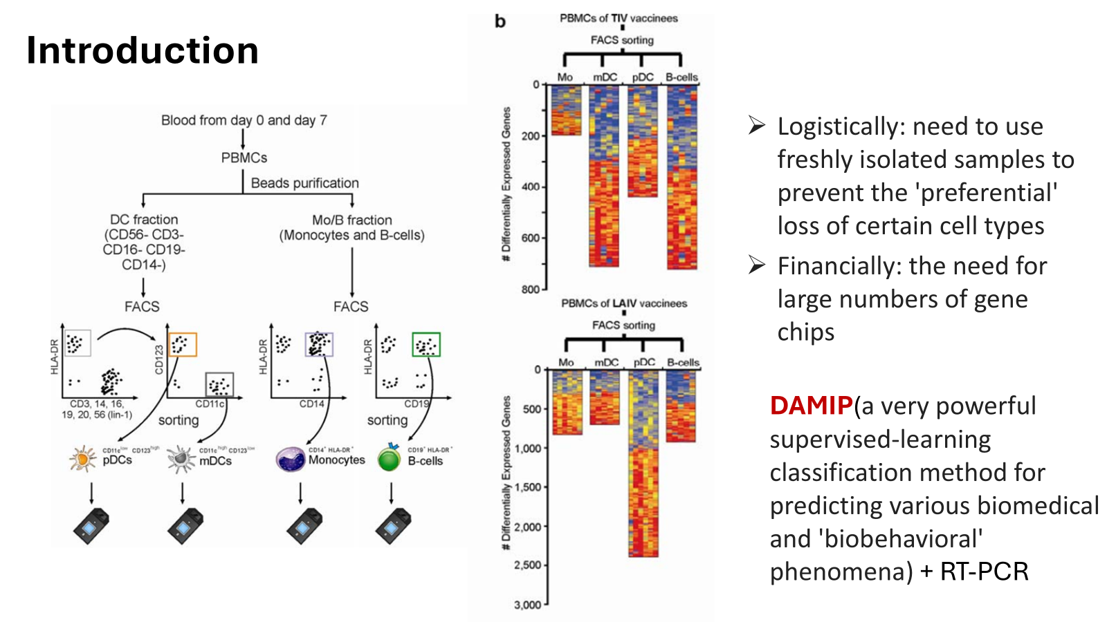

Slide 8
Methodology
Notes:
Now we’re gonna dive in to the systems biology methods of the study.

Slide 9
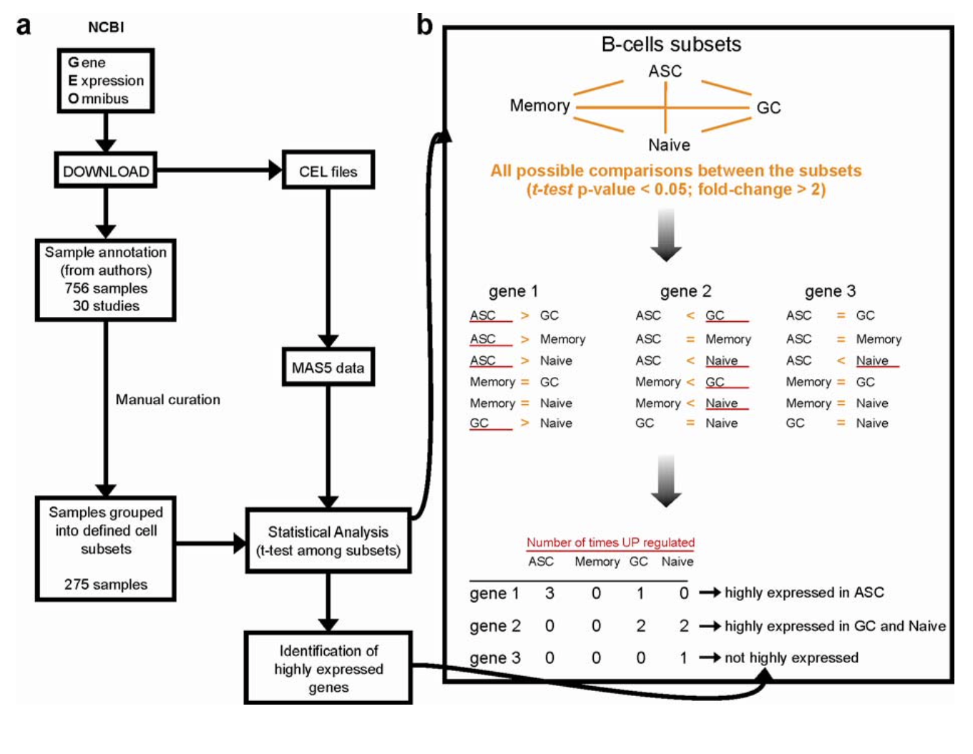
Why meta-analysis?
Self-conducted microarray analysis via flow cytometry = time and resource consuming
Meta-analysis: combining and analysing data from several studies to identify gene-expression patterns
Larger sample set
More efficient analysis
Cell-specific results
Notes:
Like mentioned previously, the authors found that their initial approach to evaluating gene-expression signatures at a cell-specific level via flow cytometry was very inefficient being both time and resource consuming,, So they devised an alternative strategy using meta analysis that took advantage of already existing studies on cell type–specific differential gene expression in complex tissues, providing them with a larger sample set for identifying important gene signatures, a more efficient computational-based method of analysis, and more cell-specific results.

Slide 10
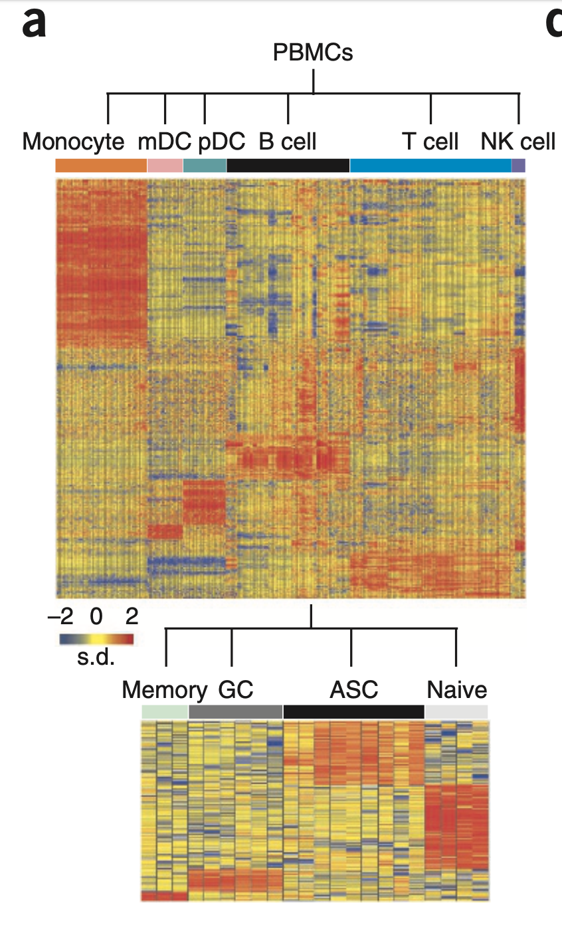
Meta-analysis of microarray data
Publicly available PBMC microarrays divided into:
T cells, B cells, monocytes, natural killer cells
B cell subsets: naive, memory, germinal center, ASCs
Identified highly expressed genes in each subset
Compared to microarray data of plasmacytoid and myeloid dendritic cells post-TIV and LAIV vaccination
Output: early gene signatures from vaccine response
Notes:
For the meta-analysis, the authors took publicly available data from previously done PBMC microarrays and separated the gene-expression profiles of isolated cell types into four categories: T cells, B cells, monocytes, and natural killer cells. Within the B cell group, they further separated the data into subgroups of naive, memory, and germinal center B cells, as well as antibody-secreting cells from the blood and tonsils, to get a better understanding of the exact adaptive immune mechanisms involved.
With this wide array of data, they used statistical analysis to identify highly expressed genes specific to each cell type, and compared the resulting gene signatures from the meta-analysis to microarray data they obtained from plasmacytoid and myeloid dendritic cells post-vaccination with TIV or LAIV. This analysis outputted cell-specific gene signatures related to the early vaccine responses of TIV and LAIV, as well as an implication (to some degree) of each gene’s role in the innate or adaptive immune response. This differs from what we saw on Tuesday with the yellow fever vaccine predictive model because the gene signatures they used in that model to predict antibody response were unrelated to the gene signatures they identified from the YF-17D immune response, while in this case, the authors cross-referenced the cell-type specific gene signatures with gene signatures found in vaccinated individuals.
(Used only Affymetrix Human Genome U133 Plus 2.0 Arrays or Affymetrix Human Genome U133A Arrays to avoid cross-platform normalization (i.e. data is of the same toolkit) )

Slide 11

Machine Learning: Background
Machine Learning (ML) allows systems to learn and improve from data
ML relies on algorithms to complete a task using data patterns
Supervised Learning
often used for classification algorithms
model is trained with a known, labeled dataset
using results data from one dataset to classify results of another dataset
Notes:
This brings us to the main technique we want to focus on, which is the machine learning the researchers conducted
Machine Learning is used to allow systems to learn and improve from existing data. It relies on algorithms to learn to complete a task using patterns and features of the data. Many algorithms may only take certain features into consideration when making these classification guesses, and it’s part of the machine learning process to find what features are important for making distinctions in the data.
One type of machine learning that is very common is supervised learning, where a model is trained from a known labeled dataset and then tested against another labelled dataset to confirm the accuracy of the model. Supervised learning is often used for classification algorithms, where the ML will return a yes or no, A or B, blue or green type answer where the inputted data is categorized into a specific group based on patterns found in the training data set.

Slide 12
DAMIP Machine Learning
Discriminant Analysis via Mixed Integer Programming
Supervised ML → the training and testing datasets have known results
Frequently used for predicting and classifying biological processes
Application:
Influenza vaccine → determine minimum number of genes required to get an accurate classification of response type
DAMIP used to be able to predict HAI response to TIV vaccine
Trained with existing datasets to predict response in other influenza seasons
Make connections between identified genes and other vaccine responses
Notes:
In our paper, the researchers made use of DAMIP machine learning. The group of Tuesday went in depth with what DAMIP is and how it works, so I’m not going to repeat too much, but DAMIP stands for discriminant analysis via mixed integer programming and it’s often used for predicting and classifying biological processes. DAMIP made sense to use for this project because, again, it was also used to predict antibody responses to the yellow fever vaccine. The yellow fever vaccine is one of the most effective vaccines ever produced, so it makes sense the researchers wanted to try the same approach for the influenza vaccine research.
For the researchers’ purposes, they wanted to use DAMIP to determine the minimum number of genes that are required to accurately classify the response type of an individual, that is a high or low HAI titers response specifically with the TIV type vaccine. They trained the model using an existing dataset from a specific influenza season and used that trained model to test on other existing influenza season datasets. In addition to determining the number of genes required to classify responses, the researchers were also interested in identifying these genes and determine their connection to other immune and vaccine responses.

Slide 13
Results
Notes:
Moving into results, where I’ll talk also a bit more about how the meta analysis and DAMIP machine learning algorithm were used by the researchers for the influenza vaccine.

Slide 14
Meta-Analysis Results
TIV
genes upregulated are associated with high B cell expression
genes encode for antibody parts and immunoglobulins
results align with flow cytometry results
indicate high antibody response in mechanism of action in TIV
LAIV
gene upregulated are associated with high T cell and monocyte expression
genes encode for natural killer cells
results align with flow cytometry results
indicate innate response important in mechanism of action in LAIV
Notes:
The meta-analysis results showed that in the TIV vaccine, the genes that were upregulated in vaccines were associated with B cell expression, so those genes are encoding for antibody parts and immunoglobulins. What this tells us is that there is an indication that a high antibody response is heavily involved in the mechanism of action in the influenza TIV vaccine response. These results aligned with earlier finding from flow cytometry that the researchers conducted.
In contrast, the LAIV meta-analysis showed that the gene that were upregulated were instead associated with high T cell and monocyte expression, which are genes that are involved with natural killer cells in the immune system. What this indicates is that the innate immune response plays a significant role in the mechanism of action in the LAIV vaccine. Similar to with the TIV vaccine, these results align with the flow cytometry results the researchers previously conducted.

Slide 15
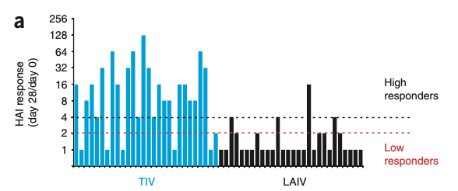
DAMIP: Background + Initial Testing
Goal: ID minimum number of genes needed to predict HAI response
DAMIP
supervised learning method for prediction biological phenomena
using TIV vaccine responses only
HAI titers response: measures level of antibodies in serum used to inhibit influenza
higher HAI → higher protection from influenza
Notes:
So just to remind everyone what I mentioned earlier, the purpose of using DAMIP for their data was to identify the minimum number of genes needed to predict the HAI response of individuals to the TIV vaccine. Only the TIV vaccine was used by the researchers because produced higher HAI responses with more variability and the group was particularly interested in analyzing the inactive vaccine over the live vaccine. If the researchers were interested in doing analysis on the LAIV vaccine, they probably would need to use another type of data other than HAI to get a better classification.
While we mentioned HAI titers earlier, just to reiterate, HAI titers is a response that measure the level of antibodies in blood serum that are used to inhibit an influenza infection. Basically, a higher HAI value means a higher protection from influenza, so a more effective vaccine is going to be one that increases the HAI value the most in the most people.

Slide 16
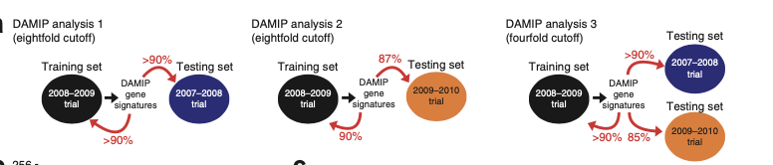
DAMIP: Initial Testing
Initial Testing:
extreme HAI classification groups
very high HAI responders ≥ 8x HAI response
very low HAI responders ≤ 2x HAI response
training establishes unbiased estimate of correct classification
2008-2009 influenza season data used for training
Notes:
The initial DAMIP testing that was done was with an extreme classification, where individuals were grouped into having either a very high HAI or very low HAI response, with high response meaning a 8-fold or more increase and low meaning a 2-fold or lower increase in their HAI value in at least one of the three influenza vaccine strains after either 3 or 7 days. Any vaccines that had an HAI increase between 2 and 8 were not considered in the training and testing of the DAMIP model.
The training data, which was data collected in the 2008-2009 influenza season, was used to establish an unbiased estimate of correct classification. Basically the training data from the season was used to establish a classification algorithm for the testing set.

Slide 17
DAMIP: Initial Test Results
Training Data: 2008-2009 influenza season
Testing Data: 2007-2008 influenza season
Results:
DAMIP identified 12 gene sets (each with 2-4 individual genes)
90+% of the low/high HAI response guesses for test data were correct based on learning from training data
Notes:
From this initial test, the DAMIP identified a minimum of 12 gene sets, each with 2-4 genes, needed to create an effective classification model. With this minimum of 12 gene sets, the algorithm correctly guesses the test data as low or high HAI responses over 90% of the time, a very effective algorithm.

Slide 18
DAMIP: Repeat Testing
Repeat Testing:
less extreme HAI classification groups
high HAI responders ≥ 4x HAI response
4x HAI response is the widely defined seroconversion after vaccination
very low HAI responders ≤ 2x HAI response
2008-2009 influenza season data used for training
Notes:
However, the researchers also wanted to test with a less extreme HAI classification, with using only a 4-fold increase as the high response instead of 8-fold. This is because a 4-fold HAI increase response is the widely considered seroconversion response following a vaccine, where seroconversion is the process of developing antibodies in the blood after exposure to a virus included through a vaccination.
This test is very similar to the test before, using the same training dataset and same low HAI response cutoff, but with two changes. First, the classification is less extreme with only a 4-fold increase in HAI for the high responses cutoff. Secondly, both the 2007-2008 and 2009-2010 datasets were tested.

Slide 19
DAMIP: Repeat Test Results
Training Data: 2008-2009 influenza season
Testing Data 1: 2007-2008 influenza season
Testing Data 2: 2009-2010 influenza season
Results
DAMIP identified 42 gene sets (each with 3-4 individual genes)
85% of the low/high HAI response guesses for test data were correct based on learning from training data
Notes:
From this repeat test, the DAMIP identified a minimum of 42 gene sets, each with 3-4 genes. With this minimum of 42 gene sets, the algorithm correctly guesses the test data as low or high HAI responses over 85% of the time, which is still very effective. The increase in the minimum number of genes needed could be caused by having greater variety in the testing dataset due to having two different years that could have two slightly different sets of vaccine responses.
Overall, the researchers found that the DAMIP training seemed quite effective in being able to identify the minimum number of genes needed to correctly classify HAI responses a vast majority of the time with the TIV vaccine type. One thing they do note is that, while effective in determining gene signatures and minimums required for classifying influenza data, they are unsure whether it can be generalized to other vaccines and future testing would be required.

Slide 20
Interesting Finds!
One of the 42 identified genes (TNFRSF17) in the repeat test also identified with predicting antibody response in YF-17D (Yellow Fever) vaccine
Five of the 42 identified genes in the repeat test are members of leukocyte immunoglobulin receptor family
Expressed by immune cells in myeloid and lymphoid lineages
Immunomodulatory roles in innate and adaptive immune system
Regulate T cells and autoimmunity
Indicates possibility of innate immune receptors in regulating antibody response
Notes:
In the process of conducting their DAMIP trials, some other interesting finds were discovered.
During that second testing phase, they found that one of the 42 identified gene sets was also identified as a gene set in predicting antibody response in the yellow fever vaccine. This could potentially indicate there is a common immune response between when these two viruses are infecting the body.
Another interesting find was that five of the 42 identified genes were show by meta-analysis to be members of the leukocyte immunoglobulin receptor family. These genes are expressed by immune cells in the myeloid and lymphoid lineages and have roles in both the innate and adaptive immune system by regulating T cells and autoimmunity. This find could indicate that there is a previously unknown role of these innate immune receptors in regulating antibody response, a process that is typically associated with the adaptive immune system.

Slide 21
Discussion
Notes:
To recap, the goal of this paper was to expand upon the results found in the yellow fever vaccine study we saw on Tuesday. Specifically, they wanted to address whether the systems biology approach used in that paper had broad utility in identifying molecular signatures and predicting immunogenicity of other vaccines. And particularly they wanted to look at different types of vaccine, in this case they looked at an inactivated one, TIV. The authors also wanted to determine if the identified molecular signatures could be informative about the underlying mechanisms of the immune system in relation to vaccine response.
Yellow fever paper showed ability to predict immunogenicity of YF-17D vaccine via gene signatures
Questions addressed:
Does this approach have broad utility in identifying molecular signatures in other vaccines, particularly in inactivated ones?
Can a systems approach be used to predict the immunogenicity of recall responses in memory T cells?
Can the molecular signatures be informative about the underlying mechanisms of immunity?

Slide 22
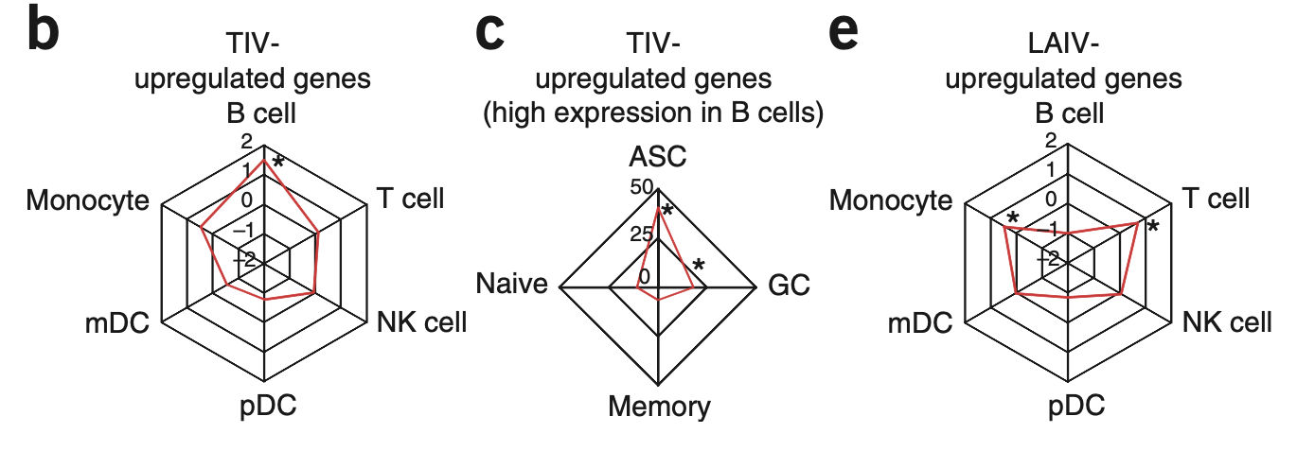
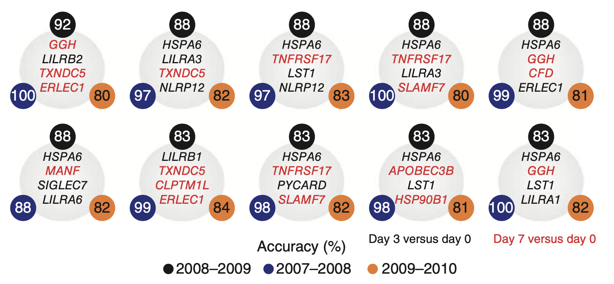
Discussion: Strengths
Meta-analysis of microarray studies >>> traditional flow cytometry
New insight to molecular mechanism of vaccine response
Immunity with LAIV vs. TIV
Identified CaMKIV & LILRs
Figure 3. Genes upregulated by TIV and LAIV
Machine learning as prediction tool for immunogenicity of vaccine
Predicted TIV with accuracy >90%
Predicts seroconversion weeks before it occurs
Figure 5c. Accuracies of machine learning technique
Notes:
Through meta-analysis of existing microarray studies, the authors were able to identify cell-specific gene signatures corresponding with the TIV vaccine response at a much faster and more efficient rate than with traditional flow cytometry. They were also able to discern the strongly innate immune response of the LAIV vaccine, which showed high expression of interferon-related genes, compared to the more antibody-heavy immune response of the TIV vaccine and an associated “unfolded protein” response (that they don’t really elaborate on) .
Even more importantly, the meta-analysis helped the authors identify new genes that were previously not associated with the adaptive immune system, like CaMKIV (calcium dependent kinase 4) and members of the leukocyte immunoglobulin-like receptor family. This discovery highlights how a systems biology approach can be informative about the underlying molecular mechanisms of action in the immune system.
From the meta-analysis results, the authors were able to train the DAMIP model to predict antibody responses based on the gene signatures found early-on post-vaccination. The predictive model identified vaccinated individuals as low responders or high responders to the TIV vaccine with an accuracy of more than 90%. This ability to predict seroconversion (or the increasing in antibody production) weeks before it occurs post-vaccination can be super advantageous especially for public health information regarding vaccine efficacy.
Together, the meta-analysis and predictive modeling show great potential in better elucidating the molecular mechanisms and immune responses of vaccines, which could significantly improve vaccine development and distribution, and the results of this study also provide strong proof-of-concept that a systems biology approach to vaccine immunology can be applied to vaccines other than YF-17D, and more specifically can be applied to different types of vaccines like live attenuated versus inactivated vaccines.

Slide 23
Discussion: Limitations
Broad utility still uncertain – gene signatures will vary for different vaccines
Overlapping genes with previous YF-17D study suggest some commonality across vaccines
Predicting vaccine efficacy is not 100% accurate
Immunogenicity ≠ Efficacy
HAI response is not the only factor influencing vaccine protection
Protective antibody concentrations vary by individual, viral strain, etc.
Only workaround = increasing HAI parameter → excludes protected vaccinees with lower HAI responses
Notes:
Despite the success of this study, there were still a lot of limitations with the design. As of 2011.
Firstly, the broad utility of this system was still pretty uncertain. Though it was proven effective for both the yellow fever vaccine and now the influenza vaccine, gene signatures most likely will differ between vaccines, so the predictive capability of this system against other vaccines still needed to be tested further. The authors did identify some overlapping gene signatures between the yellow fever and influenza vaccines, but whether these gene signatures would be present and important for other vaccine immunogenicities was unknown,,, at the time, at least.
Additionally, if the authors wanted to predict actual vaccine efficacy or protection using this model, more work was definitely needed to guarantee an accurate prediction since immunogenicity does not directly equate to efficacy. Their final model relies on gene signatures related to HAI antibody titers, but HAI response is not the only factor that affects whether or not an individual is protected by a vaccine. Protective antibody concentrations can also vary significantly based on an individual’s immune system, the viral strain present, existence previous infections, etc., and the authors’ only suggested workaround was to increase the HAI parameter from four-fold to eight-fold to guarantee that a predicted “high-responder” would also be protected by the vaccine, but this excludes protected individuals that have lower HAI reponses.

Slide 24
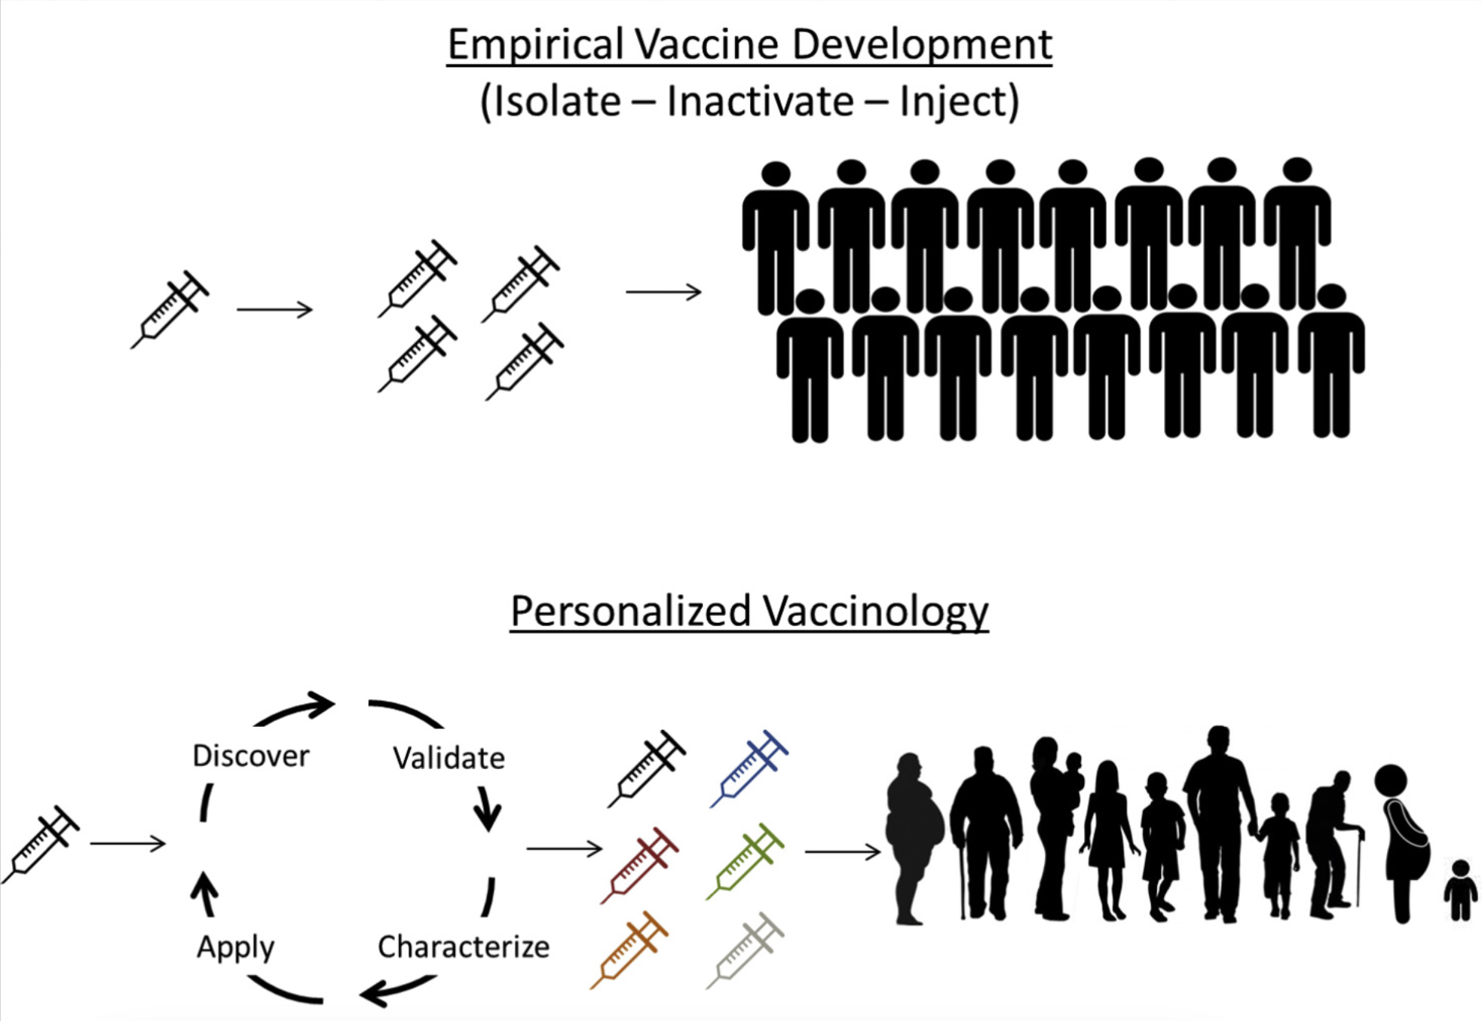
Discussion: Future steps
Improvements:
Identify other markers for vaccine protection in conjunction with HAI response
Adapt the system to other vaccines
Other applications:
Monitoring suboptimal immune responses in weaker individuals
Personalized vaccinations based on predictive modeling of individuals’ immune systems
Poland, et. al.
Notes:
Given the limitations, a more robust model was needed that would take into account other factors that influence vaccine protection alongside HAI response. The model also still needed testing against other vaccines to prove its broad predictive capabilities.
Still, the results of this study introduced a lot of potential for the use of systems biology for vaccine development and prediction. The ability to predict immune responses could significantly improve vaccine development and opens the door to the idea of “personalized vaccinations” based on the predictive modeling of individuals’ immune systems. Specifically, global profiling of innate and adaptive immune responses in relation to vaccination could be used to identify individuals with weaker immune systems who would probably have a lower antibody response, and this would allow for very specified administration of either different types of different doses of vaccines that would ensure immune protection of every individual.

Slide 25
References
Querec, T. D., Rama Akondy, Lee, E. K., Cao, W., Helder Imoto Nakaya, Teuwen, D., Pirani, A., Gernert, K., Deng, J., Marzolf, B., Kennedy, K., Wu, H., Soumaya Bennouna, Herold Oluoch, Miller, J., Vencio, R. Z., Mulligan, M., Aderem, A., Ahmed, R., & Bali Pulendran. (2008). Systems biology approach predicts immunogenicity of the yellow fever vaccine in humans. Nature Immunology, 10(1), 116–125. https://doi.org/10.1038/ni.1688
Bali Pulendran. (2009). Learning immunology from the yellow fever vaccine: innate immunity to systems vaccinology. Nature Reviews. Immunology, 9(10), 741–747. https://doi.org/10.1038/nri2629
Cowling, B. J., Wey Wen Lim, Perera, M., Fang, V. J., Leung, G. M., Peiris, M., & Tchetgen, E. J. (2018). Influenza Hemagglutination-inhibition Antibody Titer as a Mediator of Vaccine-induced Protection for Influenza B. Clinical Infectious Diseases, 68(10), 1713–1717. https://doi.org/10.1093/cid/ciy759
NCI Dictionary of Cancer Terms. (2024). Cancer.gov; Cancer.gov. https://www.cancer.gov/publications/dictionaries/cancer-terms/def/seroconversion
Poland, G. A., I.G. Ovsyannikova, & Kennedy, R. B. (2017). Personalized vaccinology: A review. Vaccine, 36(36), 5350–5357. https://doi.org/10.1016/j.vaccine.2017.07.062

